Slide 1





Workshop on LT SPICE & Hackathons Tips and tricks
AAA COLLEGE OF ENGINEERING AND TECHNOLOGY
Managed by Panjurajan – Amaravathy Trust and Promoted by Vinayaga- Sony Group of Industries
(Accredited by NAAC with an “A” grade) (An ISO TUV 21001: 2018 Certified Institution)
(Approved by AICTE, New Delhi &amp; Affiliated to Anna University, Chennai)
Amathur, Sivakasi - 626 005.
DEPARTMENT OF ELECTRONICS AND COMMUNICATION ENGINEERING
Target : 2nd year students
Goal: Greatly enhance the student's technical understanding and prepare them for success in both academic and competitive environments

Slide 2
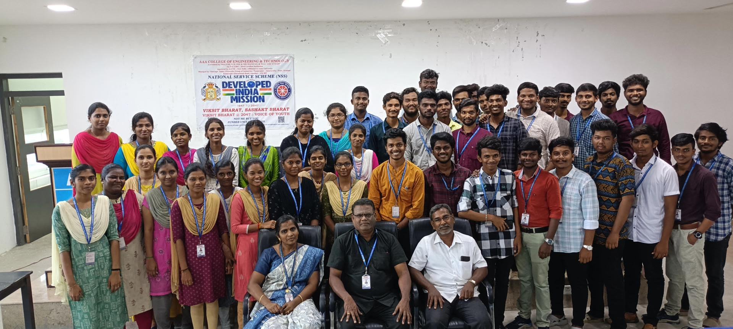
WE the Priceless brains Team

Slide 3

TEAM FORMATION
INTERVIEW PREPARATION MATERIALS
IPR-NEEDS
HACKATHON TIPS AND TRICK
PROBLEM STATEMENT
ICE BREAK SECTION
LT SPICE INSTALLATION
LT SPICE TUTORIAL
LT SPICE TASKS
IOT ONLINE SIMULATION PROJECT
WINNER TEAM WILL GET REWARD

Slide 4


Slide 5
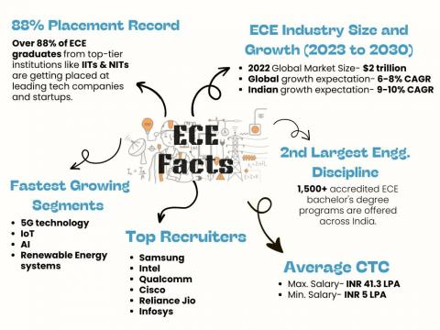

Slide 6


Slide 7

LEARN APTITUDE
Here my git hub link where you all can download the company-based questions

Slide 8
INTERVIEW PREPARATION MATERIALS
- [All Company interview Questions](https://drive.google.com/drive/folders/1NC5wLHUMUye5_5zHzSgTgXDUdVmh43ZU)
- [Complete ACCENTURE Materials](https://drive.google.com/drive/folders/1oMtiEzBmKhDloSHmbujvB9LV0WtJ0VQq?usp=drive_link )
- [Complete TCS Materials](https://drive.google.com/drive/folders/1I8QqnzZonRewbSnUMyfC9-tRduEJ4gyB )
- [Complete ZOHO Materials](https://drive.google.com/drive/folders/1EtXkhhxviVc_orwQk78wAwav-cut63Yr )

Slide 9
Form a team and name the team

Slide 10
Why IPR-Intellectual Property Rights is important to your project
Common people attached to the product easily

Slide 11

Name the machine

Slide 12
Company name:JCB Machine name: Backhoe loaders

Slide 13

Name the machine

Slide 14
Company name: Xerox Machine name:photocopier machine

Slide 15


Slide 16
Company name: Habit Machine name:bathroom cleaner

Slide 17

TOILET CLEANER BOTTLE ROYALTY

Slide 18
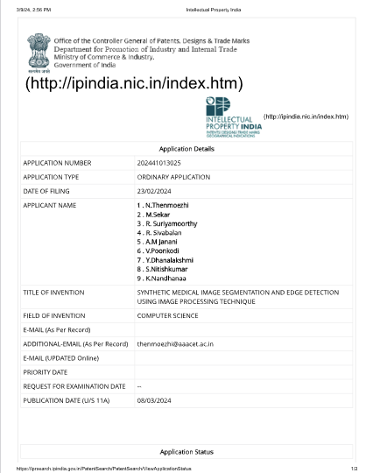

Slide 19
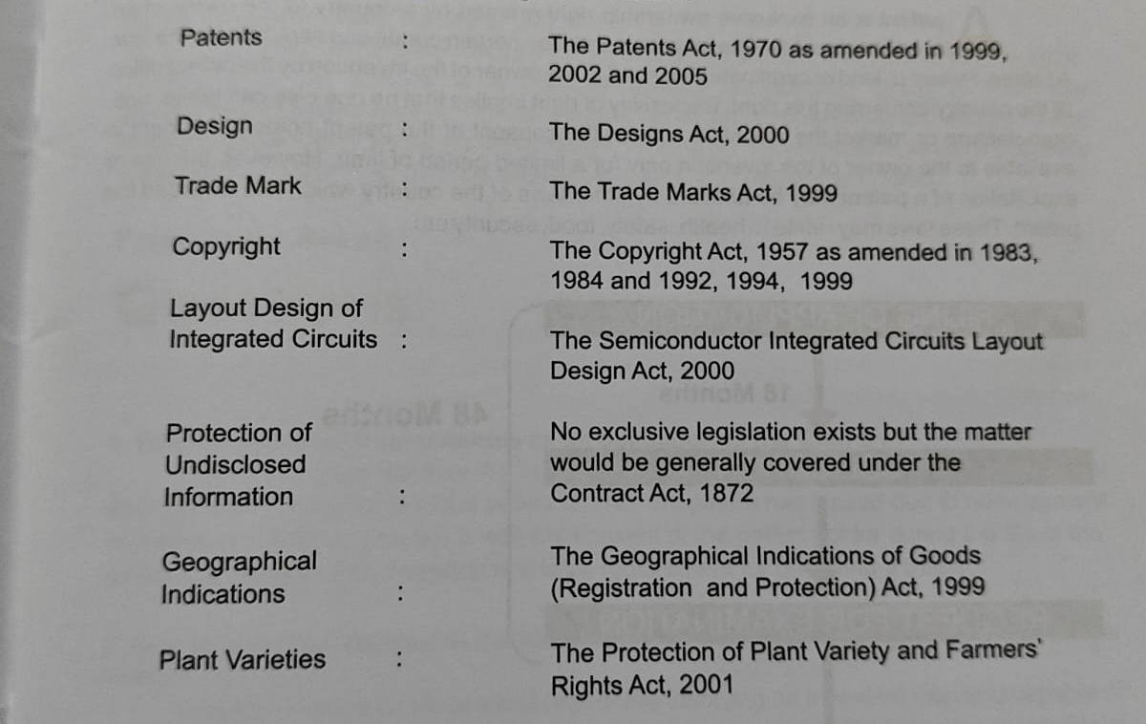

Slide 20
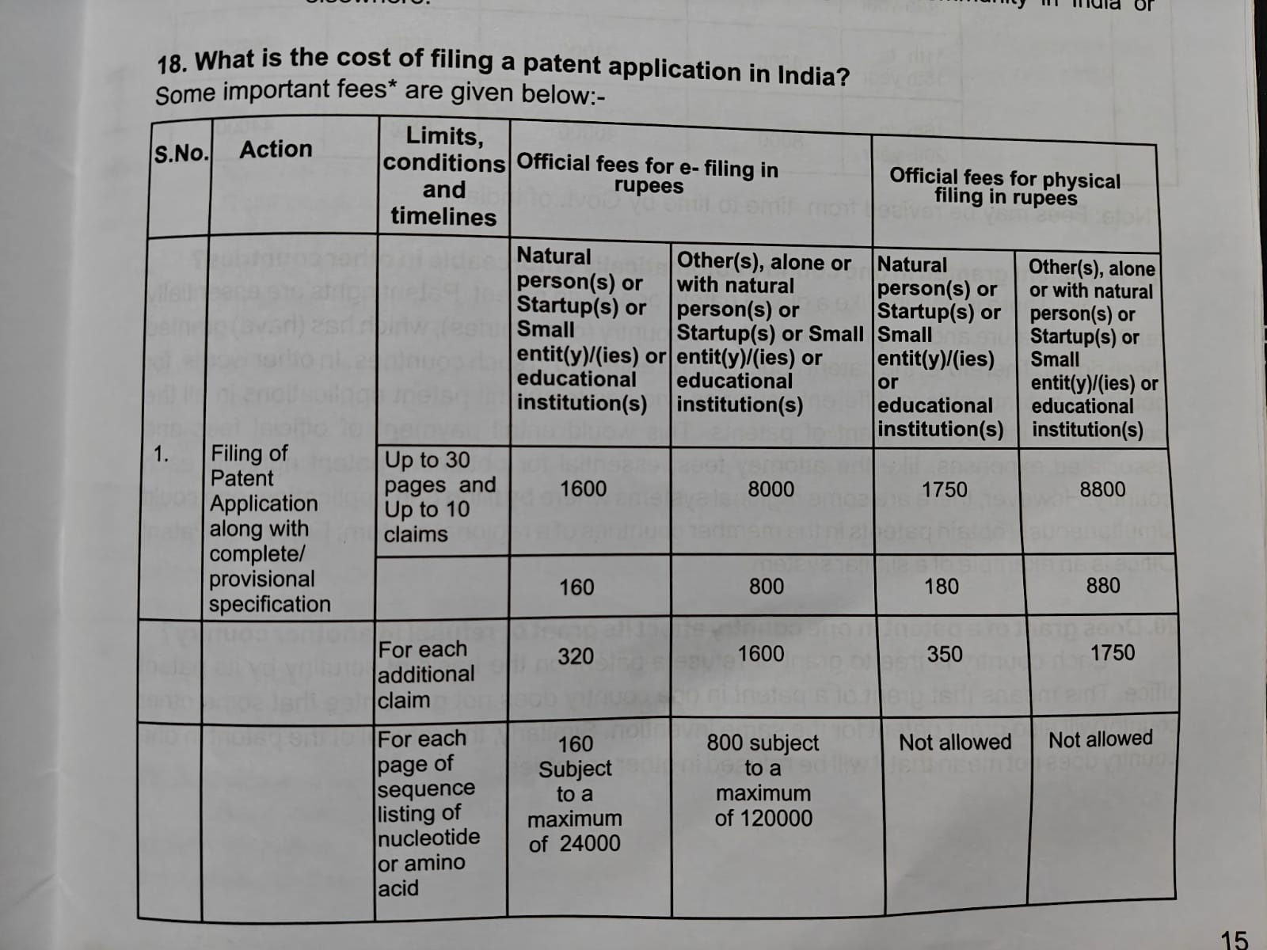

Slide 21
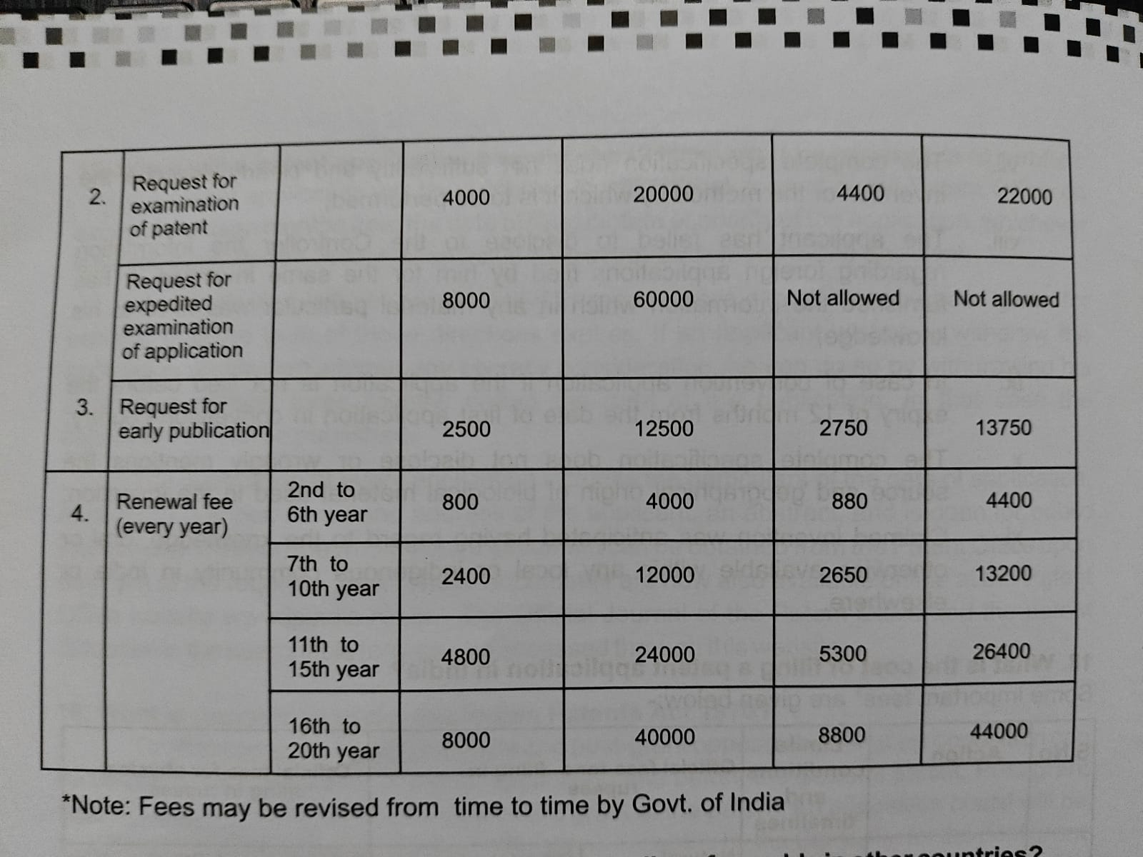

Slide 22
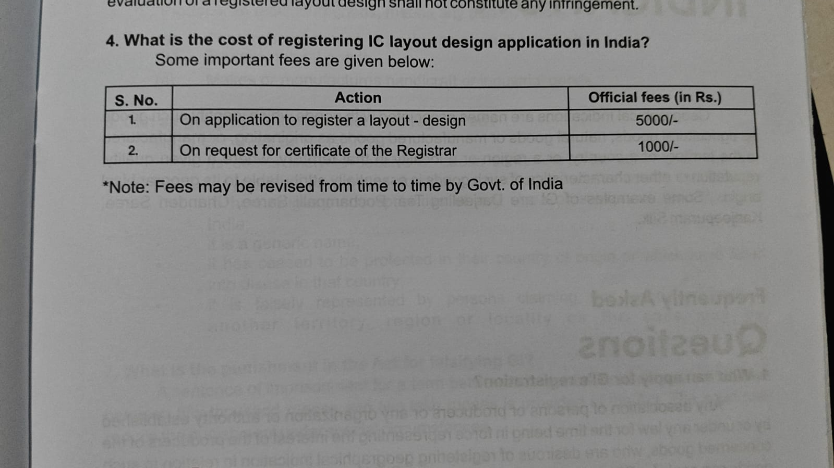

Slide 23
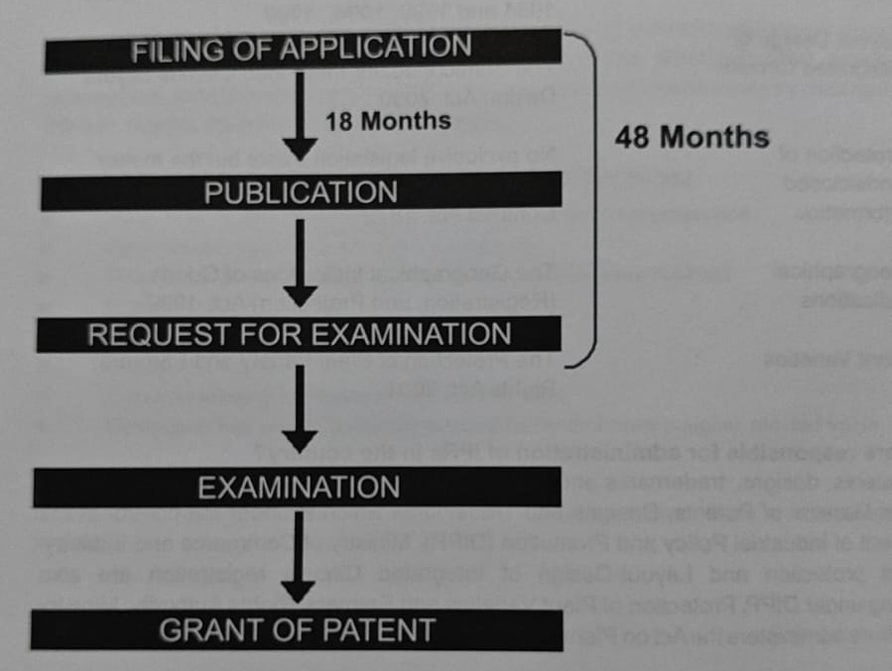

Slide 25

Tricks to crack the hackathons
Content Delivery in PowerPoint slides and flow
The demonstration Video and about the video
Poster about the project
In English presentation
Use ChatGPT but check plagiarism for the content
Working prototype

Slide 26

CONTENTS
1
PROBLEM STATEMENT
5
Proposed methodology
Road sign recognition faces challenges: low light, distorted signs
6
EXPERIMENTAL SETUP
Utilize web camera, Raspberry Pi for embedded system.
2
OBJECTIVE
Develop adaptive system for robust traffic sign detection
7
PROPOSED MVP
3
TECHNOLOGY USED
Basic model for optimal sign recognition.
!
Raspberry Pi, image processing techniques
8
OBSERVATION & CONCLUSION
4
PROPOSED ALGORITHM
Initial tests demonstrate functionality, paving the way for enhancements.
Implement lightweight algorithms for real-time sign recognition.

Slide 27
CHALLENGES WE FACED
Cost
Latency
Image Focusing
Components cost
After capture the image the processing speed will delay
Due to in efficiency of camera auto focusing issed is faced

Slide 28
Future Implementations
01
Integration with Traffic Signal Control:
Optimize signals based on real-time road conditions for efficient traffic.
Dynamic Road Sign Information Updates:
Ensure current road sign data through dynamic, real-time information updates.
02
03
Collaborative Vehicle Communication:
Enhance safety by sharing real-time road information among equipped vehicles.

Slide 29

Road Map
Activities | Weeks
 | 1 - 2 | 2-4 | 4-6 | 6-8 | 8-10
Literature survey & Procurement of components required for the projects | 1 | 1
Development of necessary software programming |  | 1 | 1 | 1
Flow diagram design |  |  |  | 1
Developing a Proposed Model |  |  |  | 1
Testing and Performance evaluation |  |  |  |  | 1
Project Validation Documentation |  |  |  |  | 1

Slide 30
Funding
S.No | Description | Justification | Rough Estimated cost in w Rs. | Reference link
1 | Raspberry pi 4+ | The Raspberry Pi 4 is equipped with a quad-core 64-bit Broadcom BCM2837 ARM Cortex-A53 SoC processor running at 1.2 GHz, making it about 50% more powerful than the Pi 2 | ₹ 4,649.00 | Link
2 | Camera | The camera captures text image of a handwritten or printed text. | ₹699 | Link
3 | Memory card | Storage | ₹769 | link
4 | Glass frame | User friendly wearable structure | ₹1,199 | Link
5 | Speaker/headset | We use general wired Speaker to get the output data. It would be ideal in delivering the exact output. | ₹1,699 | link
7 | Battery | To give power supply for the device | ₹1,499 | link
8 | Connecting jumper wires and cables | To connect the components | ₹79 | link
 | Total |  | ₹10,593

Slide 31

Revenue Stream
How is your solution different/unique from other solutions in market? (150 words)
01
Subscription
Model
Monthly/annual fees
for premium
features and content
02
Freemium Model
Basic access for free; advanced features available for purchase.
Yes, SEE
plan to have several features
04
Grants & Donations
Financial support from nonprofits and government agencies.
03
Partnerships
Collaborations with organizations for distribution and funding.

Slide 32
Any testimonials received?

Slide 33
Major Learning Outcomes:
1. Literature Survey and Research Analysis:
Research Proficiency: Developed the ability to conduct thorough literature surveys and critically analyze existing research. Gained insights into the significance of Convolutional Neural Networks (CNNs) and the VGG16 architecture in real-time image classification, particularly in the context of road sign detection and vehicle control.
2. Software Implementation Skills:
Algorithmic Implementation: Acquired practical skills in implementing complex algorithms, specifically the VGG16 CNN algorithm, for automatic road sign detection. Demonstrated proficiency in utilizing machine learning techniques for real-time applications, enhancing understanding and application of computer vision in practical scenarios.
3. Hardware Implementation Expertise:
Raspberry Pi Integration: Developed expertise in configuring Raspberry Pi and integrating it with web cameras for real-world applications. Demonstrated practical knowledge in choosing cost-effective and efficient hardware solutions, contributing to the implementation of road sign detection and vehicle control systems.
Continue …

Slide 34
4. Team Collaboration and Communication:
Effective Team Dynamics: Enhanced collaboration skills through teamwork. Contributed and shared research findings, fostering a collaborative environment where each team member's expertise in areas like machine learning, software implementation, and hardware integration was leveraged for the project's success.
5. Product Development and Practical Applications:
MVP Development: Applied theoretical knowledge to develop a Minimum Viable Product (MVP). Understood the iterative process of product development, from design stages to the selection of a user-friendly model. Gained practical experience in translating concepts into real-world applications.
Project Specific Outcome:
Real-World Impact Developed an understanding of the critical role CNN VGG16 plays in real-time road sign detection and vehicle control. Recognized the potential implications for road safety and the reduction of accidents caused by human error. Explored the broader applications of machine learning and computer vision in areas such as autonomous vehicles and smart cities, demonstrating an awareness of technology's impact on society.

Slide 35
Why should our project win?
our project deserves to win because it combines innovation, impact, cost-effectiveness, and simplicity to address a critical societal issue – road safety. By revolutionizing the way road signs are detected and interpreted, we're paving the way for a safer, more efficient transportation system for everyone.
Impact: Our project, "Automatic Road Sign Detection and Vehicle Control Using Neural Networks," promises to have a profound impact on road safety. By proactively detecting road signs and enabling automated vehicle control based on this information, we're directly addressing one of the leading causes of road accidents – driver negligence. With the potential to prevent countless accidents and save lives, our project stands to make a significant positive impact on society.
Innovation: Our project stands at the forefront of innovation in the field of intelligent transportation systems. By harnessing the power of deep learning algorithms, specifically the VGG16 Convolutional Neural Network architecture, we're revolutionizing the way road signs are detected and interpreted in real-time. This innovative approach not only improves accuracy and reliability but also sets a new standard for road safety technology.
Continued…

Slide 36
Cost-Effectiveness: Utilizing the Raspberry Pi platform and minimal additional components, our solution offers a cost-effective alternative to traditional road safety systems. By leveraging affordable hardware and open-source software, we're making advanced safety technology accessible to a broader audience, including individuals and organizations with limited resources.
Simple Architecture: With a streamlined architecture comprising Raspberry Pi, camera, and neural network model, our solution embodies simplicity and efficiency. This simplicity not only facilitates easy deployment and maintenance but also enhances scalability and adaptability to diverse environments. By eliminating unnecessary complexities, we're ensuring that our technology remains accessible and user-friendly for all stakeholders.

Slide 37
Opportunity
Don’t skip the existence
Focus
CTS – COGNIZANT- Technoverse
ACCENTURE-INNOVATION CHALLENGE
EY-challenge
E-yantra-Robotics-competition
TATA
Startup-TN
EDII
Niral Thiru Vila
SEED
And use unstop, lindklin etc,,,,,,,,

Slide 38
Platform
Follow The principal email
Check the department notice board
Unstop
Techgig
Hackerrank
Kaggel
Hack2skils

Slide 39

Learn your books and
Follow your parent and Teachers
Find your road map……….

Slide 40
Problem statement Title
Smart City Innovations for Sustainable Living
Enhancing Accessibility through Technology
Future of Healthcare: AI-Driven Diagnostics
Automated Waste Management Solutions
Financial Inclusion through Digital Platforms
Bridging the Education Gap with Tech
Next-Gen Road Safety and Accident Prevention
Climate Action: Predicting and Preventing Disasters
Data-Driven Solutions for Mental Health
Revolutionizing E-commerce with AI and AR

Slide 41
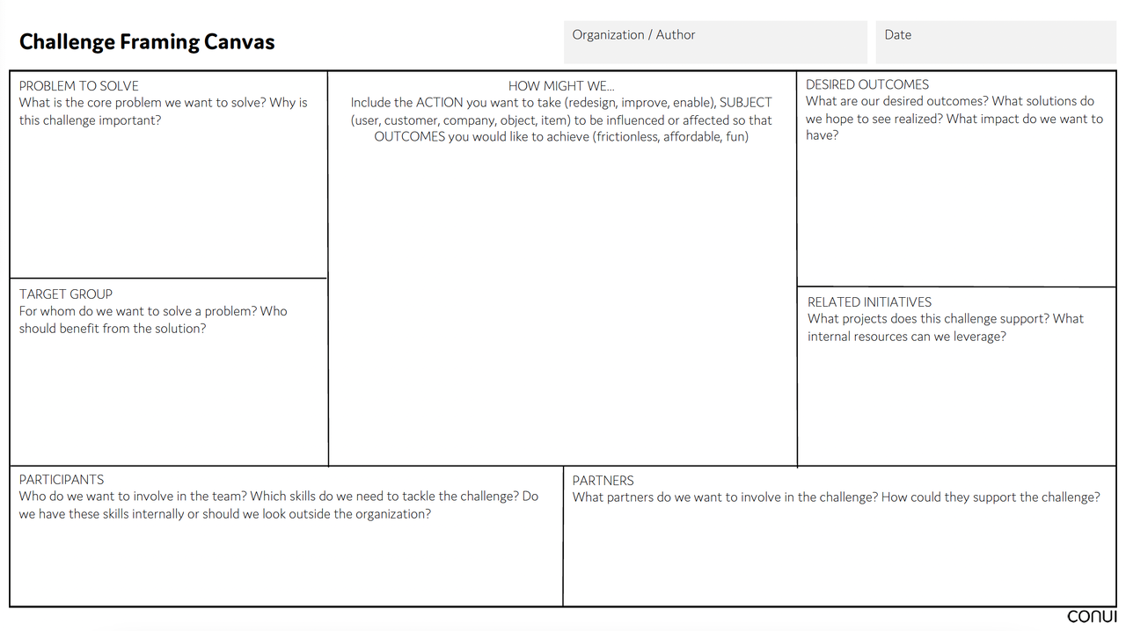

Slide 42
Let’s play the GAME
ICE BREAK SECTION

Slide 43
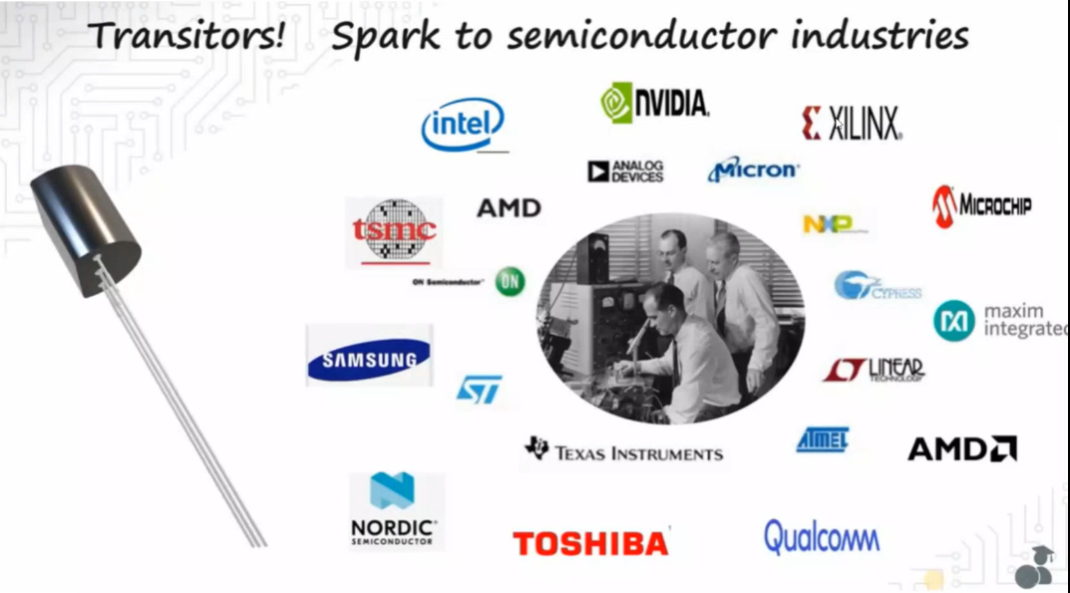

Slide 44
LIST THE COMPANY LIST

Slide 45


Slide 46
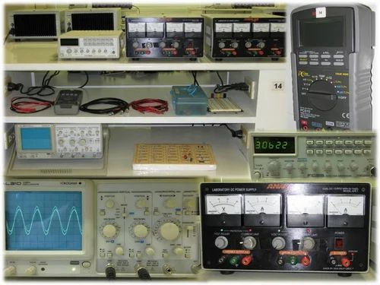

Slide 47
LIST THE COMPONENT LIST

Slide 49

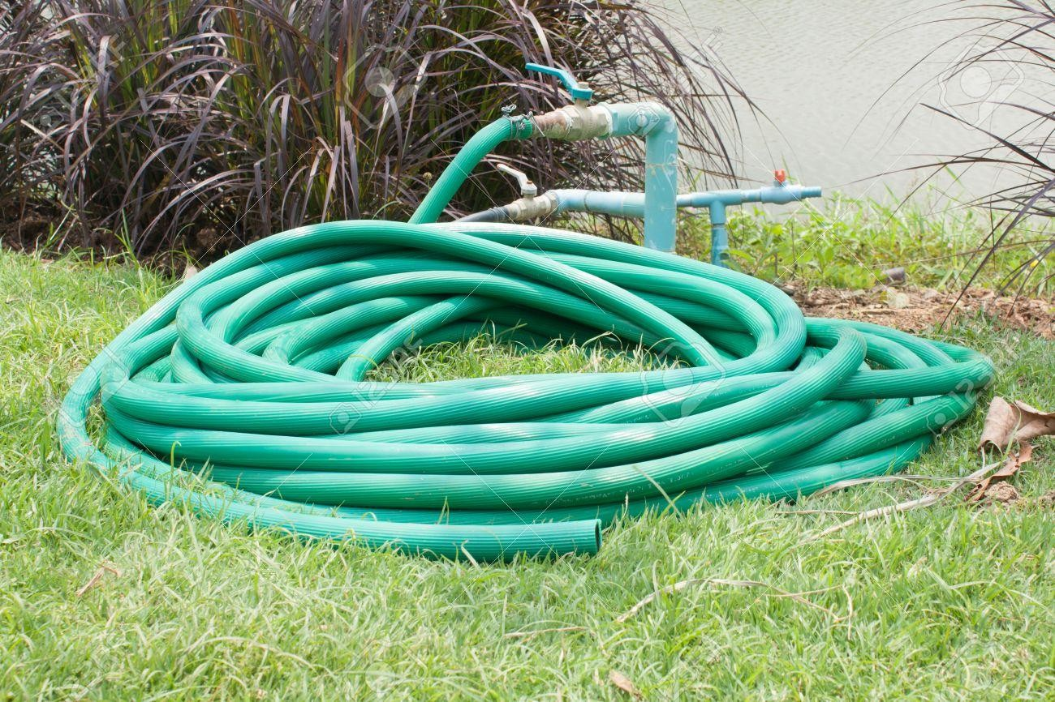
CONNECT IT…….!!!!!!

Slide 51


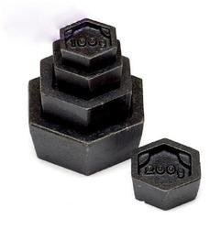
CONNECT IT…….!!!!!!

Slide 53


CONNECT IT…….!!!!!!

Slide 55

CONNECT IT…….!!!!!!

Slide 57


…….!!!!!!?????

Slide 59








Slide 61



+
+

Slide 63


WHICH LOGO IS CORRECT?

Slide 65


Slide 67


+

Slide 69


+

Slide 71


WHICH LOGO IS CORRECT?

Slide 73


+

Slide 75


WHICH LOGO IS CORRECT?

Slide 77

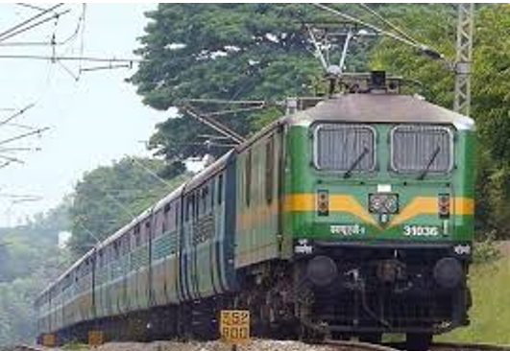
+

Slide 79


+

Slide 81


WHICH LOGO IS CORRECT?

Slide 83

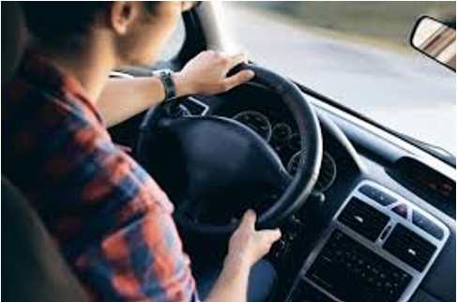
+

Slide 85


+

Slide 87


WHICH LOGO IS CORRECT?

Slide 88
How! Where! Projects
AI & ML REAL-TIME PROJECTS
https://youtu.be/4O1rs7mrNDo?si=nQx13JEMw2lvHTPD
IOT-EMBEDDED SYSTEM
https://youtu.be/5xKyZrwn2t8?si=kneGv90jGYxYAn-k
VLSI AND SYSTEM DESIGN
https://youtu.be/rWOQ3qwH02g?si=s1QEr8xIBmN-zSUO
DEVOPS
https://youtu.be/Ou9j73aWgyE?si=9wO9MAz2ceM48rb0
DJANGO IN PYTHON
https://youtu.be/g5vFWHajutg?si=TJNvLM2-7WSN2Ah2
DIGITAL MARKETING (SEO)
https://youtu.be/9ZxHSIaP_6A?si=ySxy787MZPjC7V5i
VERILOG
https://youtu.be/YE-JrestfRw?si=LCu-ZTpjGPyeUAua

Slide 89
What is the role
Electronics Design Engineer
Networking Engineer
Embedded Systems Engineer
Telecom Engineer
VLSI Design Engineer
Signal Processing Engineer
Software Developer
Data Analyst
AI/ML Engineer
IoT Developer

Slide 90
இது நம்ம COMPANY

Slide 91
What and why LTSPICE
●
What ?
Analog part of pspice simulation software
Drawing interface and component library provide by LTC
●
●
●
Why ?
Free download on www.linear.com/designtools/software/ Easy to use
But only analog analysis
●
●
●

Slide 92
Objective
See the different ways to use this software
Use LTSpice as an help during futur studys and projects
●
●

Slide 93
OVERVIEW
Main simulation tools
.OP : calculate the opearting point of a circuit
.DC : the same as .OP but for several value of one/several voltage(s) or current source. The result is given in a graph
.TRAN : use simulator as a scope to see the timing diagram of differents signals
.AC : calculate the frequency response of circuit
●
●
●
●

Slide 94
Analysis
Different steps to perform a simulation
Create a new sheet and save it on a folder specially created for all the files of the simulation
Drawing schematic
•
Place and move component. Don't forget the ground Place wire to connect components
Place label to mark the most important node
•
•
Set the analysis (.OP, .DC, .TRAN or .AC)
Run simulation 5.Interpret results

Slide 95
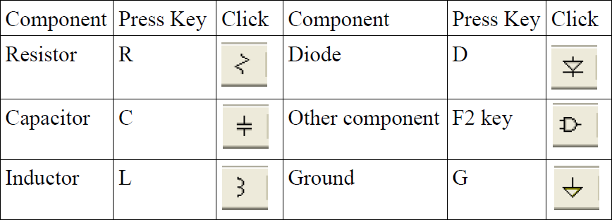
Drawing schematic
Place and move component
Select component by press a key or click on the correspondant pictures in the tool bar
Move the mouse until the position you want, and left click to place the component.

Slide 96

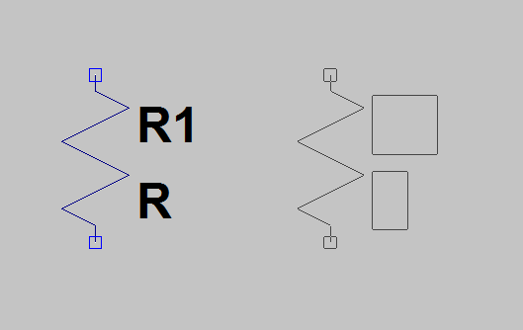
Drawing schematic
Place and move component
To move and rotate a componant, it must be select (grey). It's not, select it whith and use « CTRL+R » to turn it, and mouse to move it.
Fixed component, cannot move or rotate
Not fixed component, can move and rotate

Slide 97

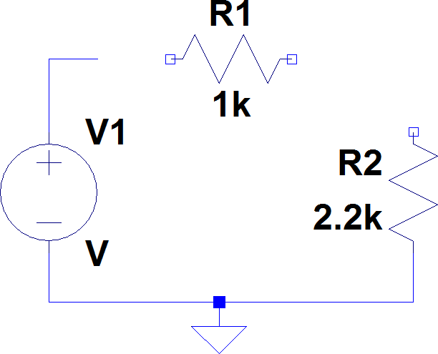
Drawing schematic
Connect component : trace wire
Press « F3 » key or click on to select wire tools.
Left click to change direction
Left click on the
the
terminal point of
other component what you want connect, or riht click to finish the wire
Left click on the terminal point of one component to begin

Slide 98

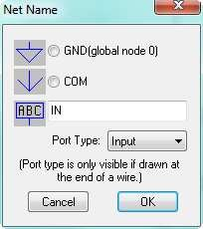
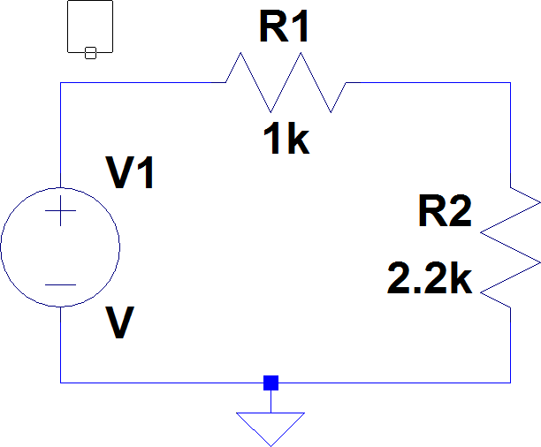
Drawing schematic
Place label
Press « F4 » key or click on to select label tools.
Place the node on the wire on what you want give name.
Comment : label can also be use to connect 2 nodes. Just give the same name at the 2 nodes

Slide 99
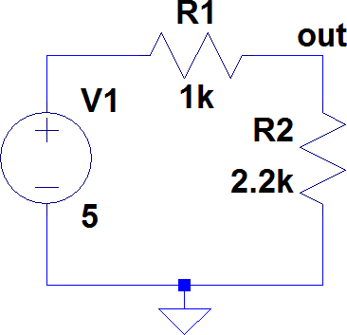
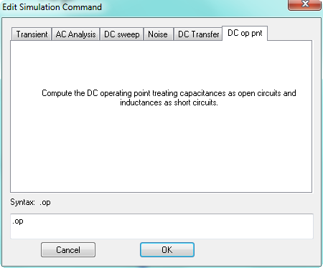
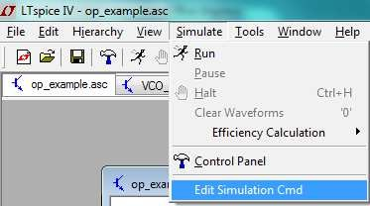
.OP analysis
1. Draw the schematic study, and modifie (Right click on V) the DC voltage of V1
DC value
2. Setting the analysis

Slide 100
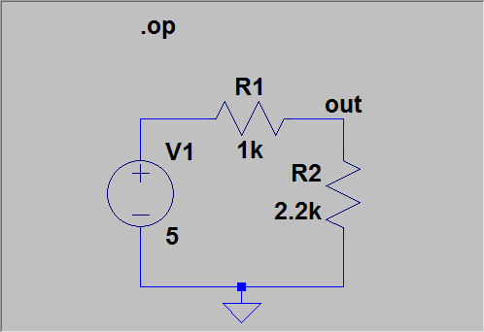

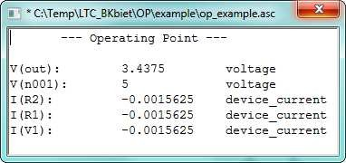
.OP analysis
3. Click on schematic to valid your choice
left click on the schematic to put it
4. Run the analysis
A new window appears and contains the value of the operating point

Slide 101
.DC analysis
●
Perform .op analysis for any value of one (or more) voltage (or current) source(s).
Example: with the same circuit,we want to know how change the output voltage, if the input change.
You need only change the analysis setting by choosing DC sweep
●
●

Slide 102
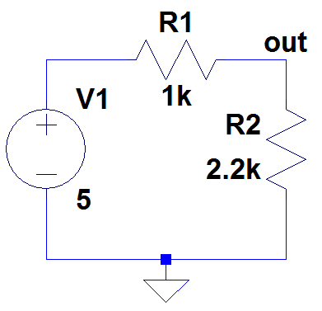
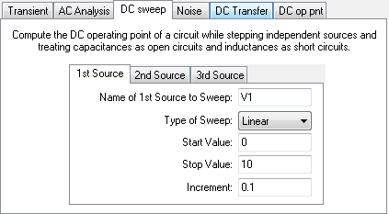
.DC analysis
Setting
Setting the DC sweep analysis
●
Name of the source which change of value Linear, octave, decade or list of value
First value simulate Last value simulate
Voltage range between two simuation

Slide 103
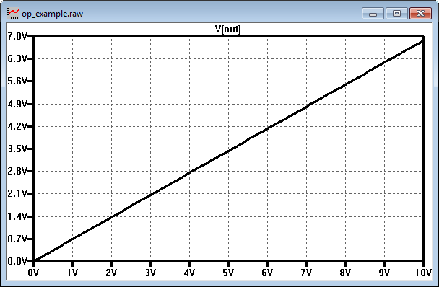
.DC analysis
Result
Result is a graph :
●
Linear scale
Horizontal axis : value of V1
Step between 2 values
Start value
Stop value

Slide 104
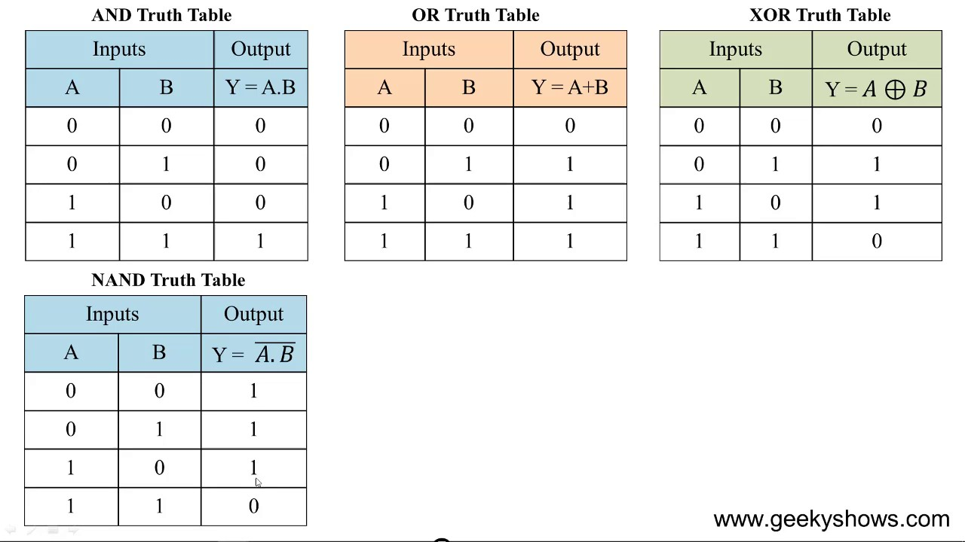

Slide 105
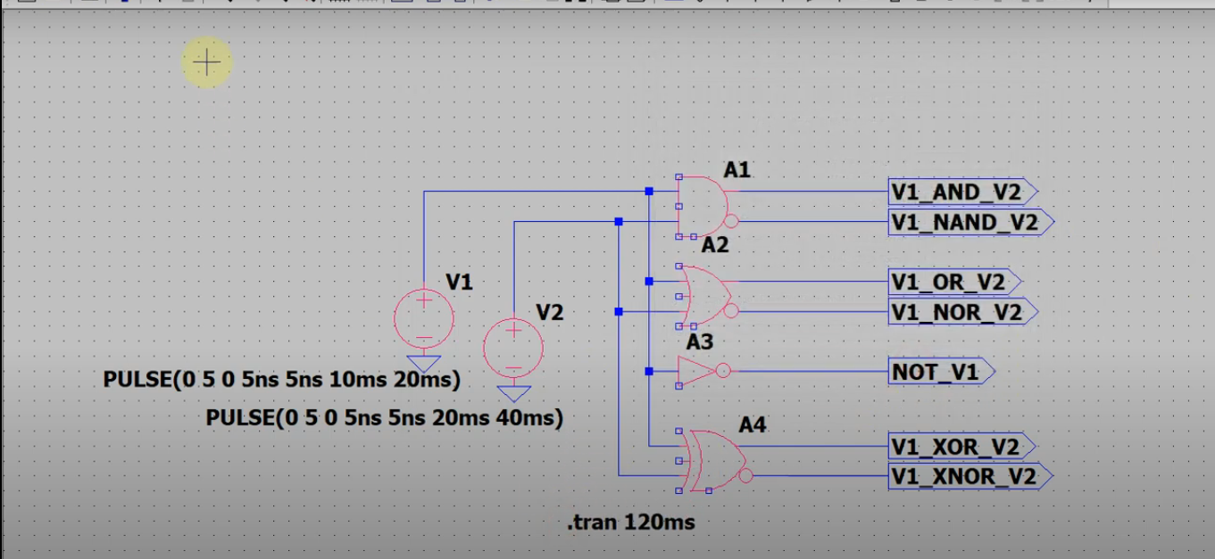
Basic 2-Input Logic Gates simulation

Slide 106
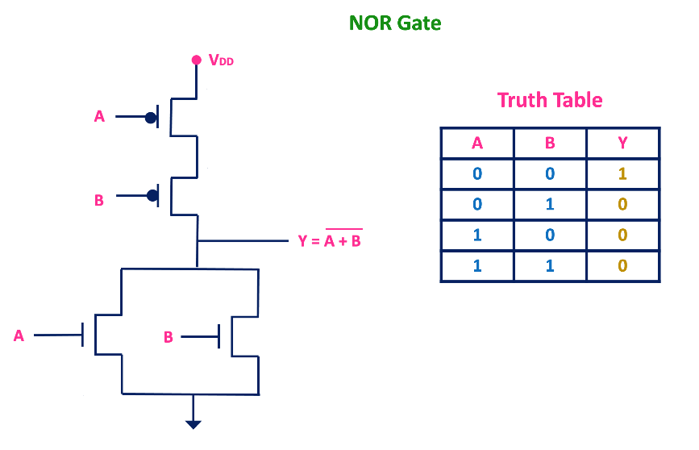
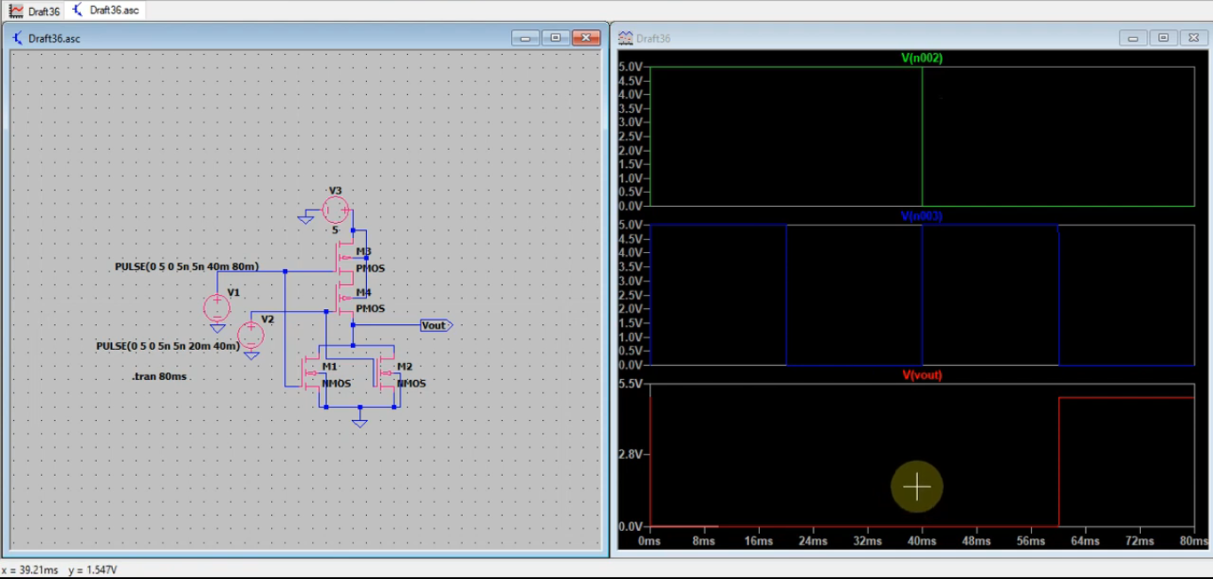
NOR gate using CMOS in LTSpice

Slide 107
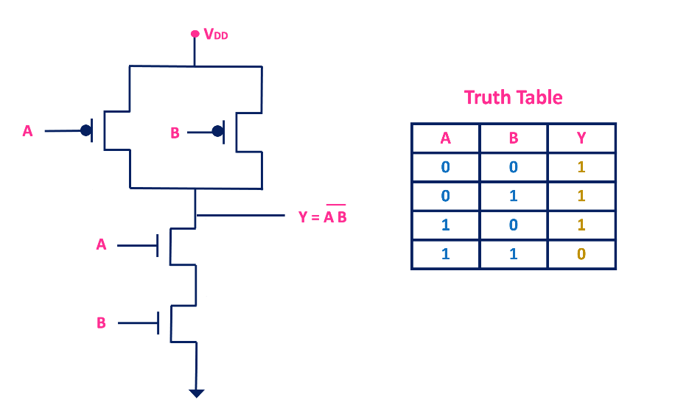
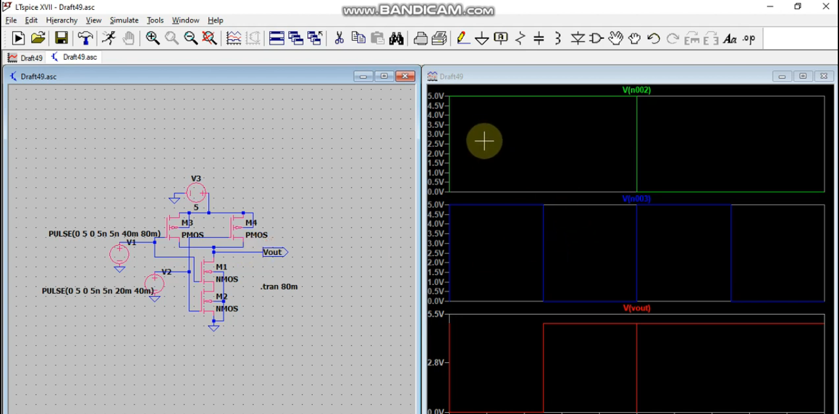
NAND using CMOS in LTSpice

Slide 108
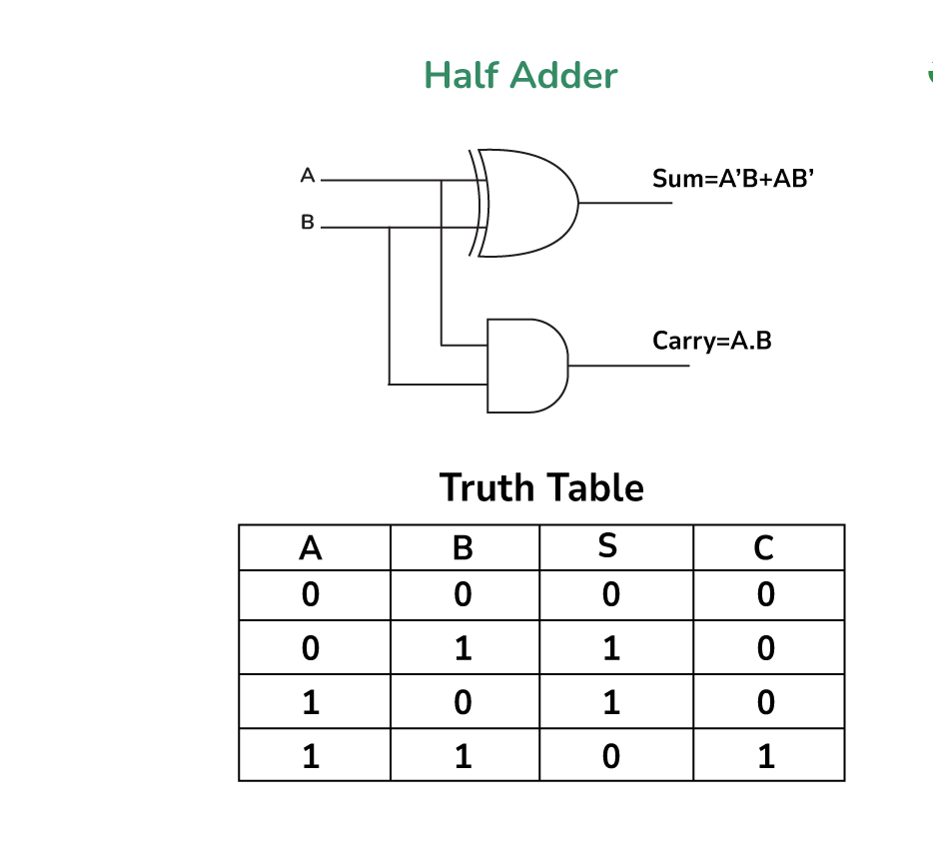
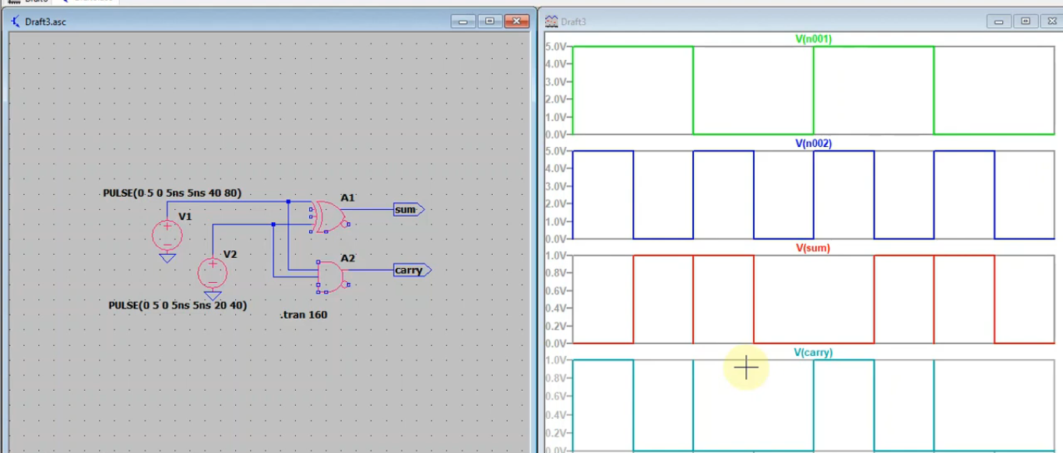
Half Adder simulation in LTSpice

Slide 109
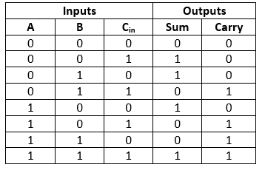
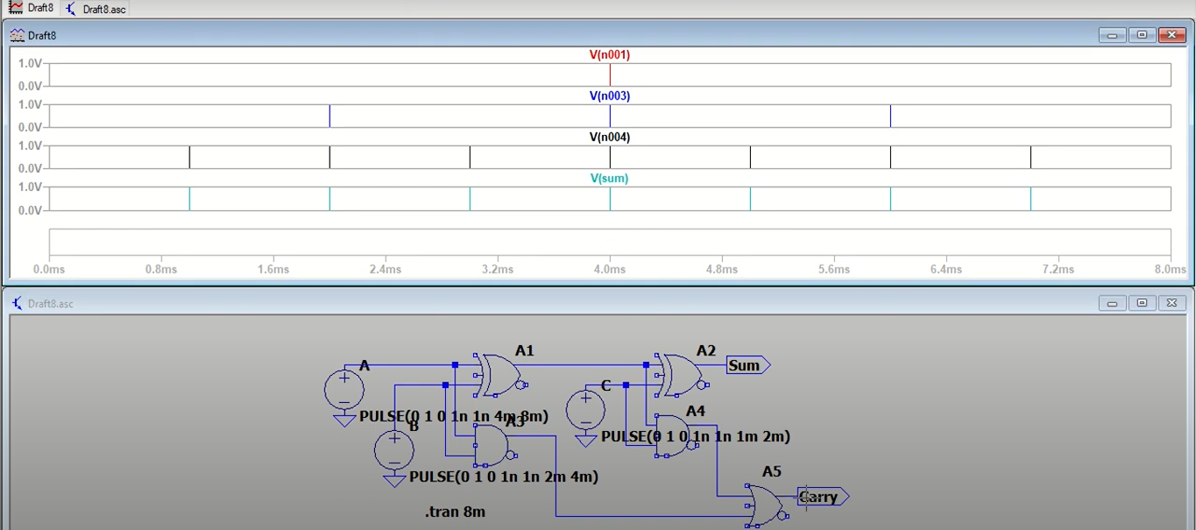
Full Adder

Slide 110
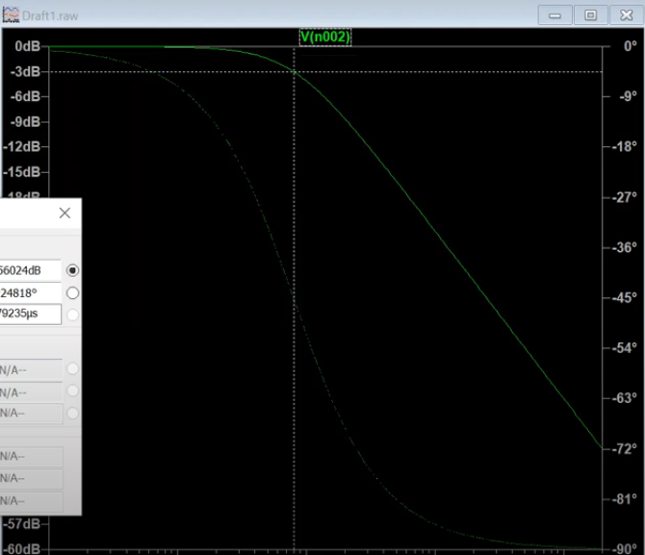
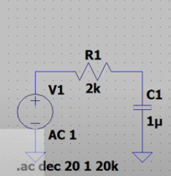
Low pass filter simulation in LTSpice

Slide 111
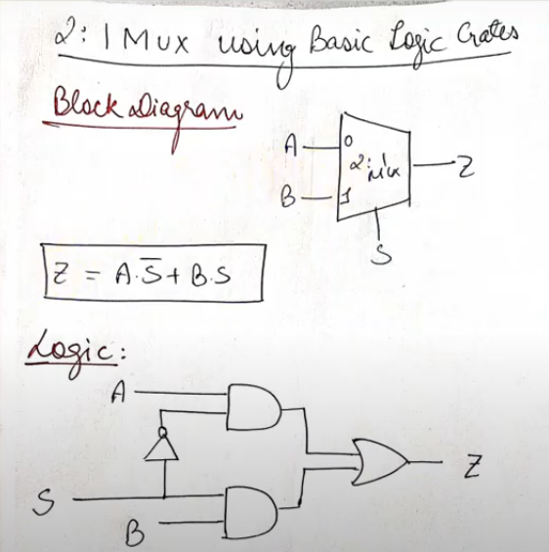
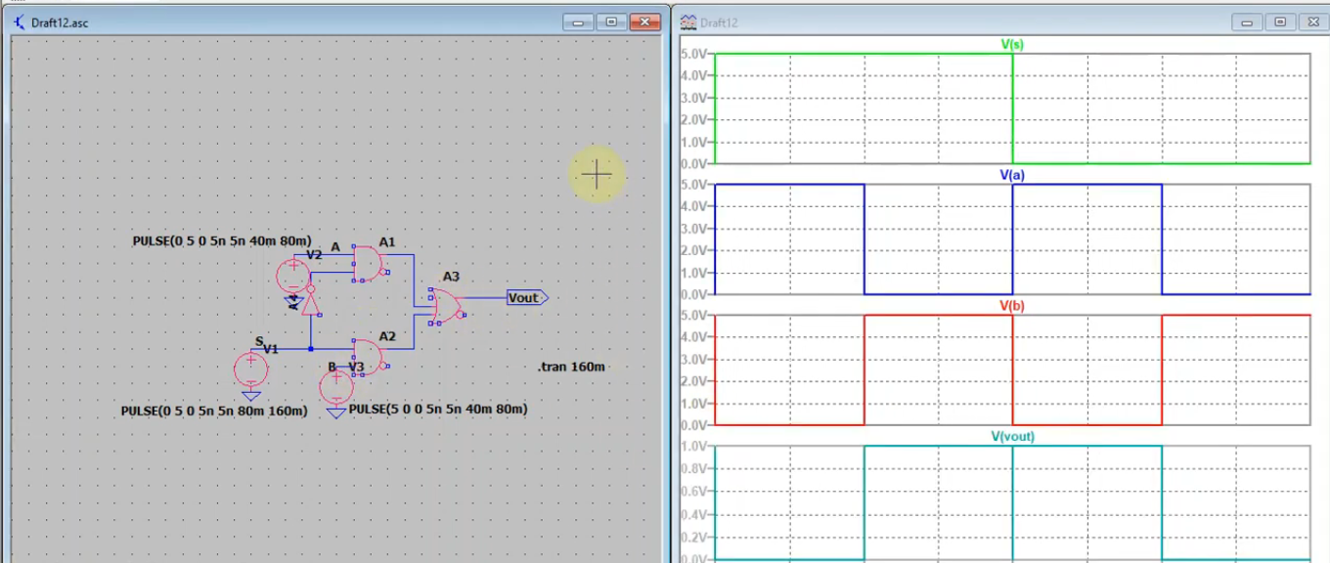
2:1 MUX Simulation in LTspice

Slide 112
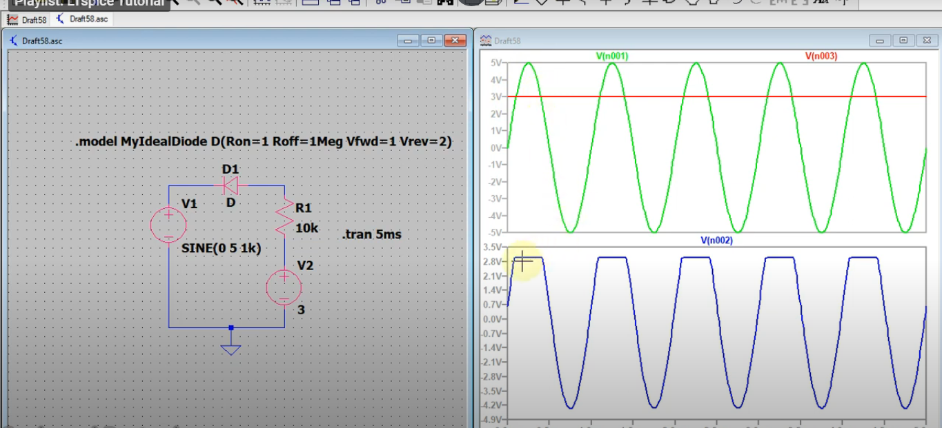
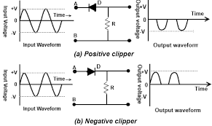
Clipper Circuit simulation in LTspice

Slide 113
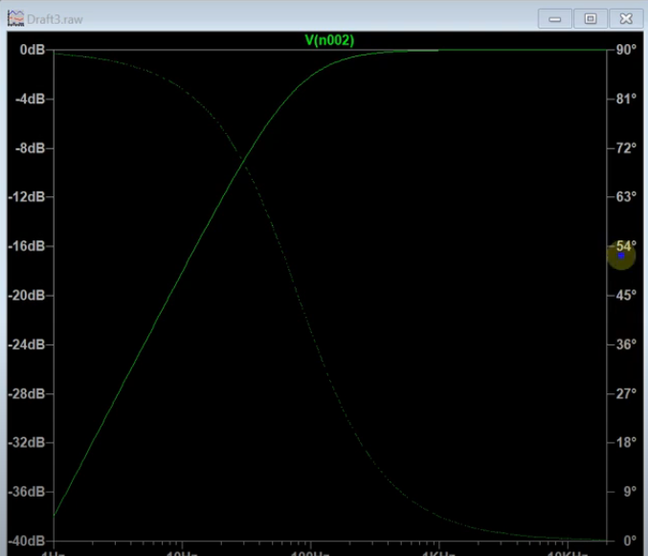
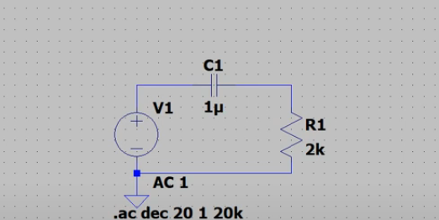
High Pass Filter simulation in LT-Spice

Slide 114
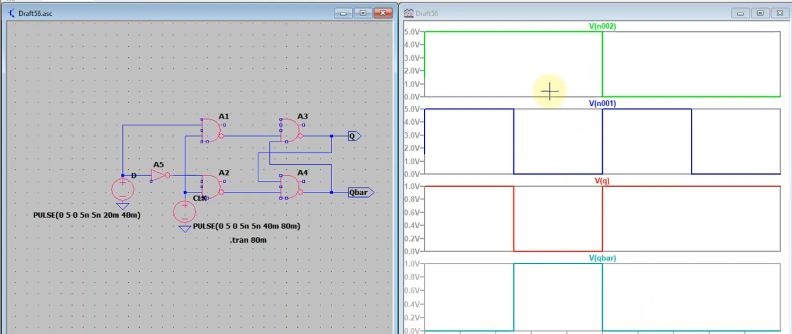
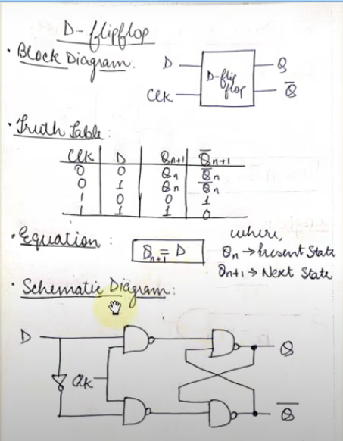
LT-spice Simulation of D Flip-flop using NAND gates

Slide 115
IOT – ONLINE SIMLUATOR & VLSI LAYOUT DESGIN
Continue…..

Slide 116

TINKERCAD

